Slide 1


Chapter 23: Gauss’ Law

Slide 2
23.1 What is Physics?:
Gauss’ law relates the electric fields at points on a (closed) Gaussian surface to the net charge enclosed by that surface.
Gauss’ law considers a hypothetical (imaginary) closed surface enclosing the charge distribution.

Slide 3
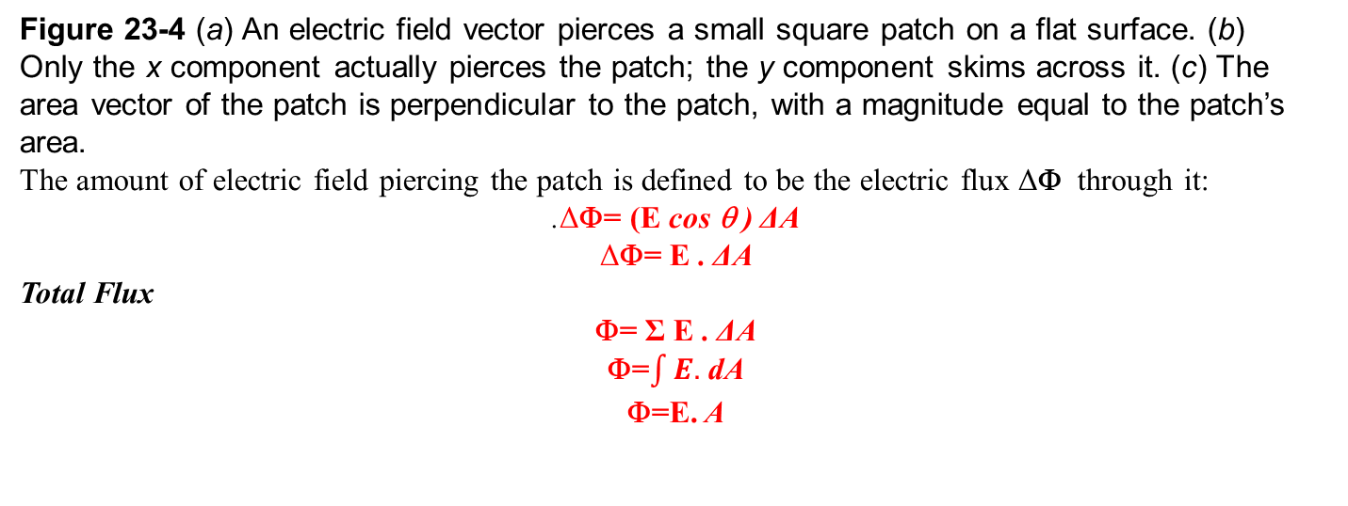
Electric Flux

Slide 4
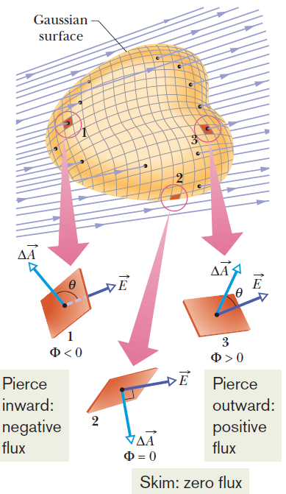


Flux of an Electric Field
The electric flux through a Gaussian surface is proportional to the net number of
electric field lines passing through that surface.
Fig. 23-5 A Gaussian surface of arbitrary shape immersed in an electric field. The surface is divided into
small squares of area ΔA. The electric field vectors E and the area vectors ΔA for three representative squares, marked 1, 2, and 3, are shown.
we shrink the squares to patch elements with area vectors dA and then integrate:
180° > θ >90°

Slide 5
Flux is a scalar (we talk about field vectors but flux is the amount of piercing field, not a vector itself). The SI unit of flux is the newton–square-meter per coulomb (Nm²/C).
Φ= EA
Φ= -EA
Φ= 0
Φ= 0

Slide 6
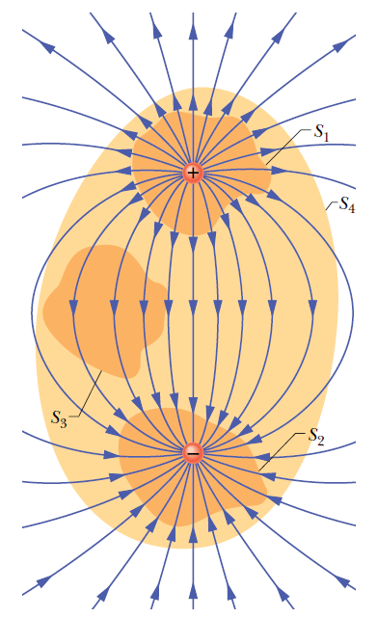


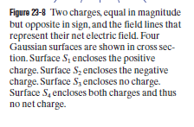
23.2 Gauss’ Law:
Gauss’ law relates the net flux of an electric field through a closed surface (a Gaussian surface) to the net charge q_{enc} that is enclosed by that surface.
The net charge q_{enc} is the algebraic sum of all the
enclosed positive and negative charges, and it can be positive, negative, or zero.
If q_{enc} is positive, the net flux is outward; if q_{enc} is negative, the net flux is inward.

Slide 8

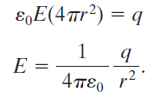
23.5 Gauss’ Law and Coulomb’s Law:
Figure 23-9 shows a positive point charge q, around which a concentric spherical Gaussian surface of radius r is drawn. Divide this surface into differential areas dA.
The area vector dA at any point is perpendicular
to the surface and directed outward from the interior.
From the symmetry of the situation, at any point the electric field, E, is also perpendicular to the surface and directed outward from the interior.
Thus, since the angle θ between E and dA is zero, we can rewrite Gauss’ law as
This is exactly what Coulomb’s law yielded.

Slide 9
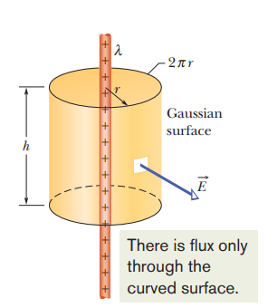


23-4 APPLYING GAUSS’ LAW: CYLINDRICAL SYMMETRY
Figure shows a section of an infinitely long cylindrical plastic rod with a uniform charge.
We want to find an expression for the electric field magnitude E at radius r from the central axis of the rod, outside the rod

Slide 10
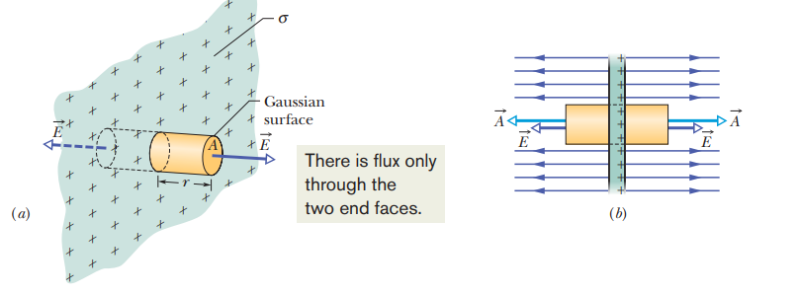

23-5 APPLYING GAUSS’ LAW: PLANAR SYMMETRY
Figure shows a portion of a thin, infinite, nonconducting sheet with a uniform (positive) surface.
A sheet of thin plastic wrap, uniformly charged on one side, can serve as a simple model.

Slide 11

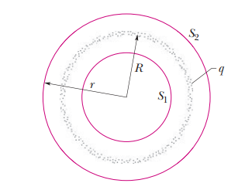
23-6 APPLYING GAUSS’ LAW: SPHERICAL SYMMETRY

Slide 12
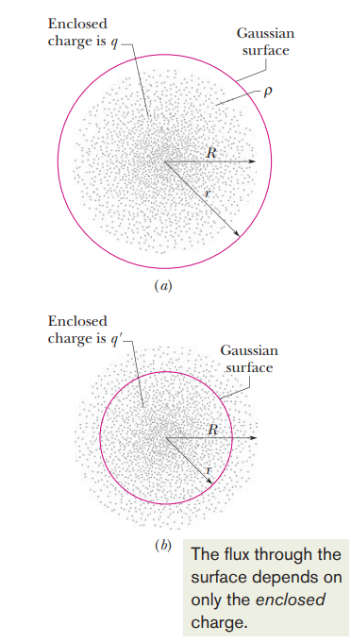

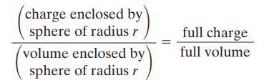
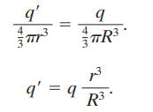


If the full charge q enclosed within radius R is uniform, then q enclosed within radius r in Fig. b is proportional to q

